Slide 1
Lead User Guide:
Training Provider Dashboard
Updated 01/04/2019
Notes:
The instructions will cover CDX updates for the New Training Provider Dashboard role.

Slide 2
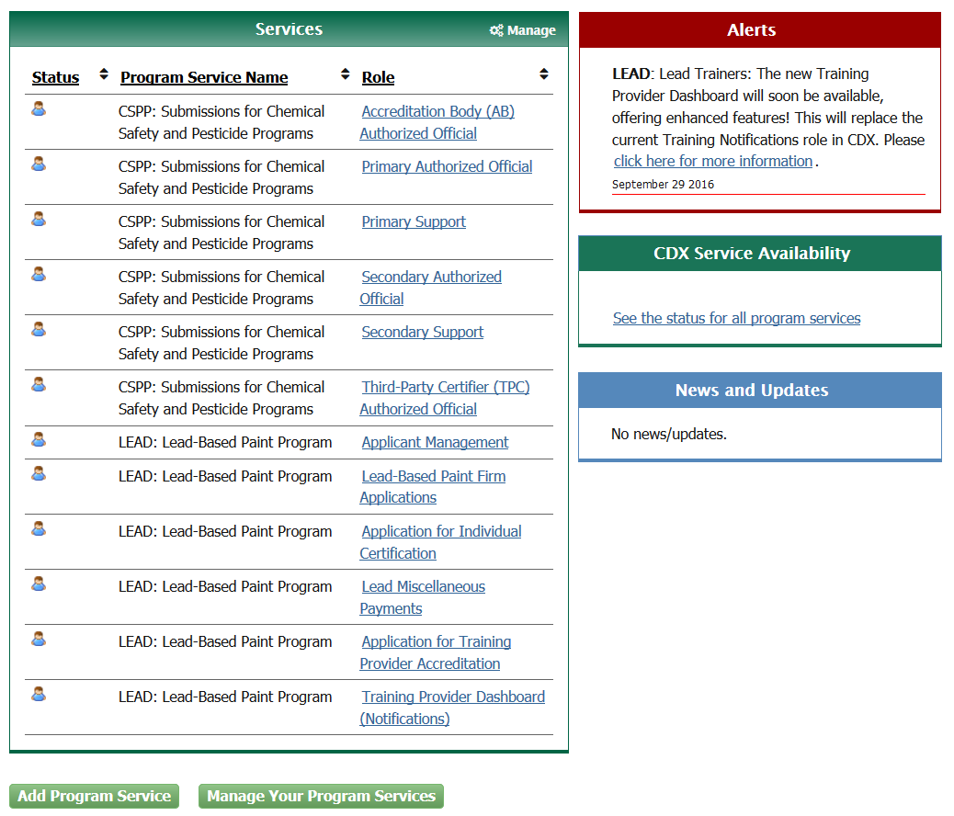
Lead Training Provider Dashboard
Notes:
The handoff from CDX using "Training Notifications" has changed. Once the user is logged into CDX, they will be able to locate the NEW "Training Provider Dashboard (Notifications)" link under "Services" in place of the former "Training Notifications" link.

Slide 3
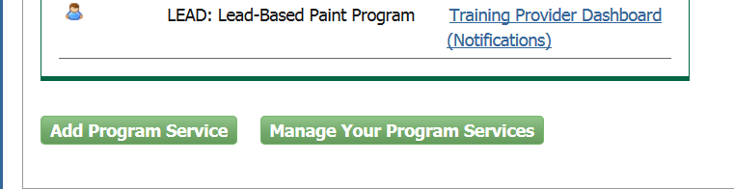
Lead Training Provider Dashboard
Notes:
Handoff from CDX using the NEW "Training Provider Dashboard (Notifications)" link located under the role column on the "MyCDX" Homepage. This link is already available to those who previously had the "Training Notifications“ link.

Slide 4
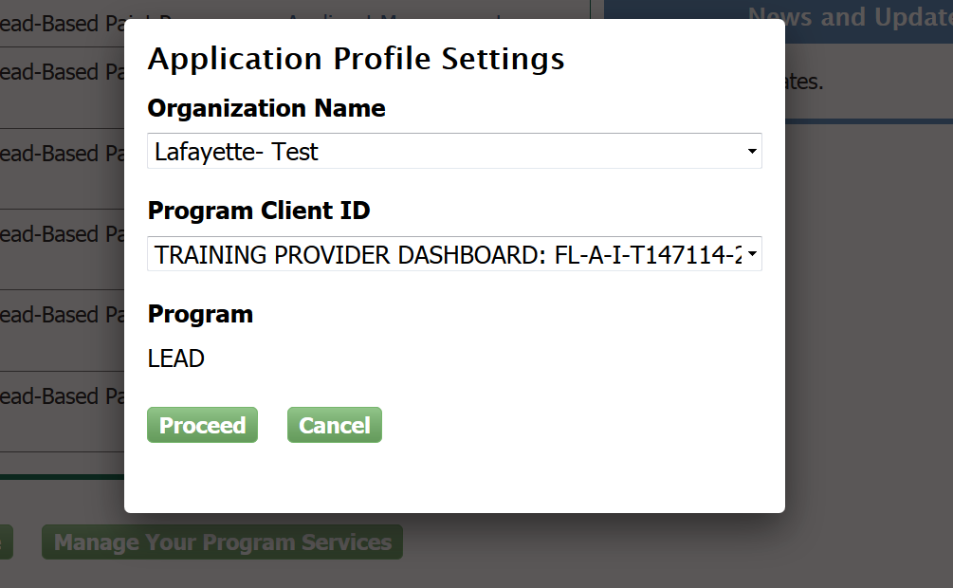
Lead Training Provider Dashboard
Notes:
If a user has multiple Organization Names or Accreditation Numbers associated with their CDX account, they will be prompted to select which account Training Provider they are working for before proceeding to the dashboard.

Slide 5
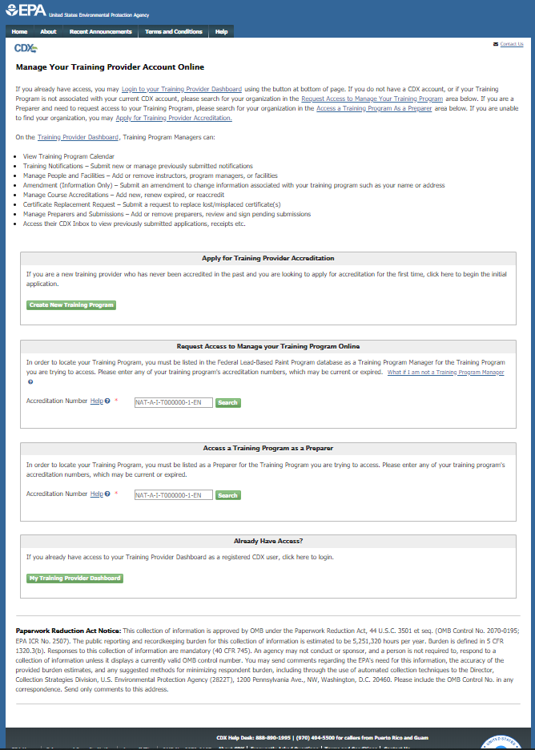
Lead Training Provider Dashboard
https://cdx.epa.gov/XCDX/LeadTpCertification/Public
Notes:
Users can also access their Training Provider Dashboard by navigating to the Training Provider Public Site, located at https://cdx.epa.gov/XCDX/LeadTpCertification/Public. Users click “My Training Provider Dashboard” to login.

Slide 6
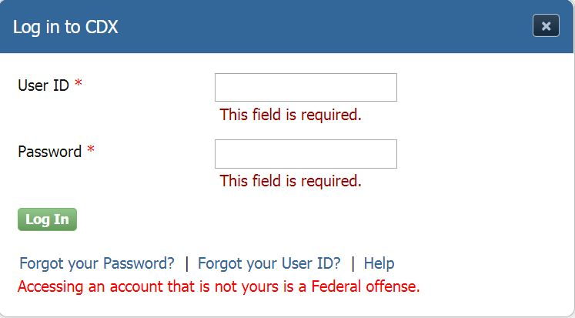
Lead Training Provider Dashboard
Notes:
The CDX Login screen will display after the user clicks “My Training Provider Dashboard.“ The user should enter their CDX login information here.

Slide 7
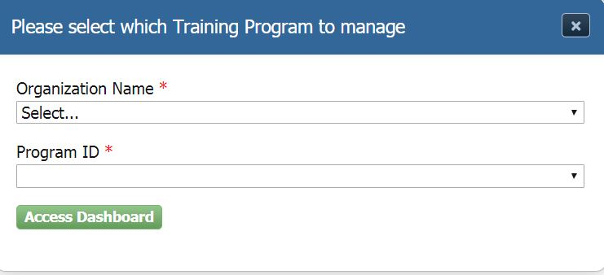
Lead Training Provider Dashboard
Notes:
If a user has multiple Organization Names or Accreditation Numbers associated with their CDX account, they will be prompted to select which account Training Provider they are working for before proceeding to the dashboard.

Slide 8
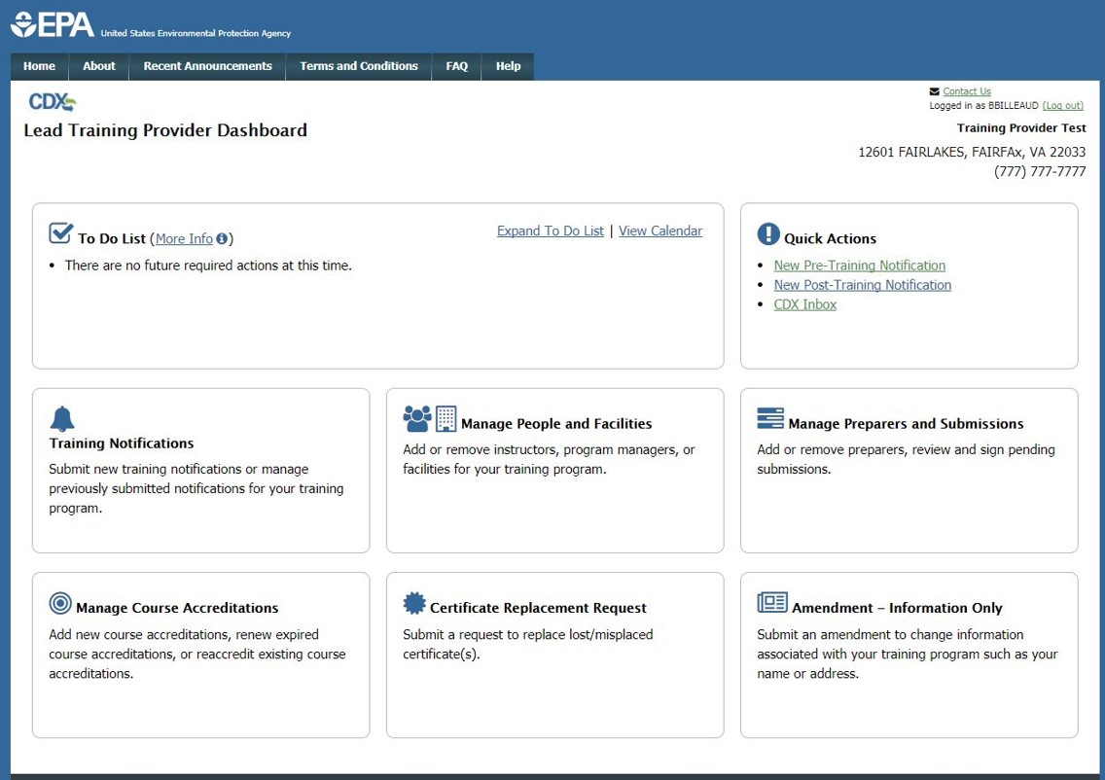

Training Notifications
Notes:
Users desiring to submit a training notification will click the "Training Notifications" tile.

Slide 9
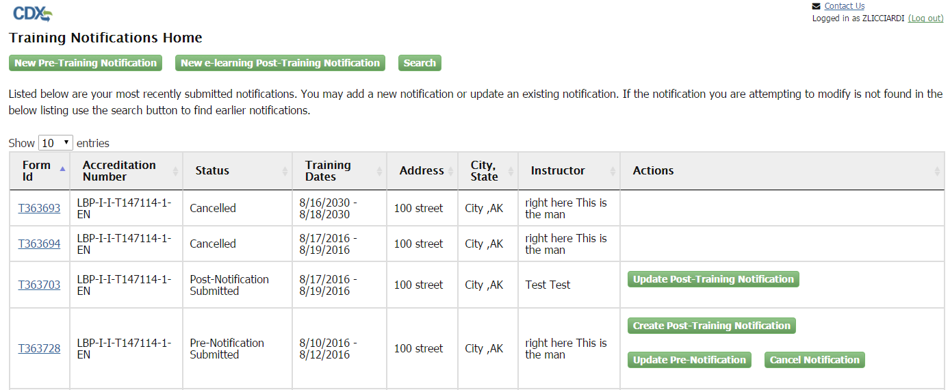
Training Notifications
Notes:
Once the user accesses the "Training Notifications Home" page, the functionality is the same as it was before the deployment of the new Training Provider Dashboard. If user is new to Training Notification, please see the Lead User Guide on Training Provider Notification for more information.

Slide 10
Manage People and Facilities
Notes:
Users wishing to submit an amendment to add or remove a Training Program Manager, Principal Course Instructor, or Training Facility can navigate to the "Manage People and Facilities" page from the dashboard by clicking the "Manage People and Facilities" tile.

Slide 11
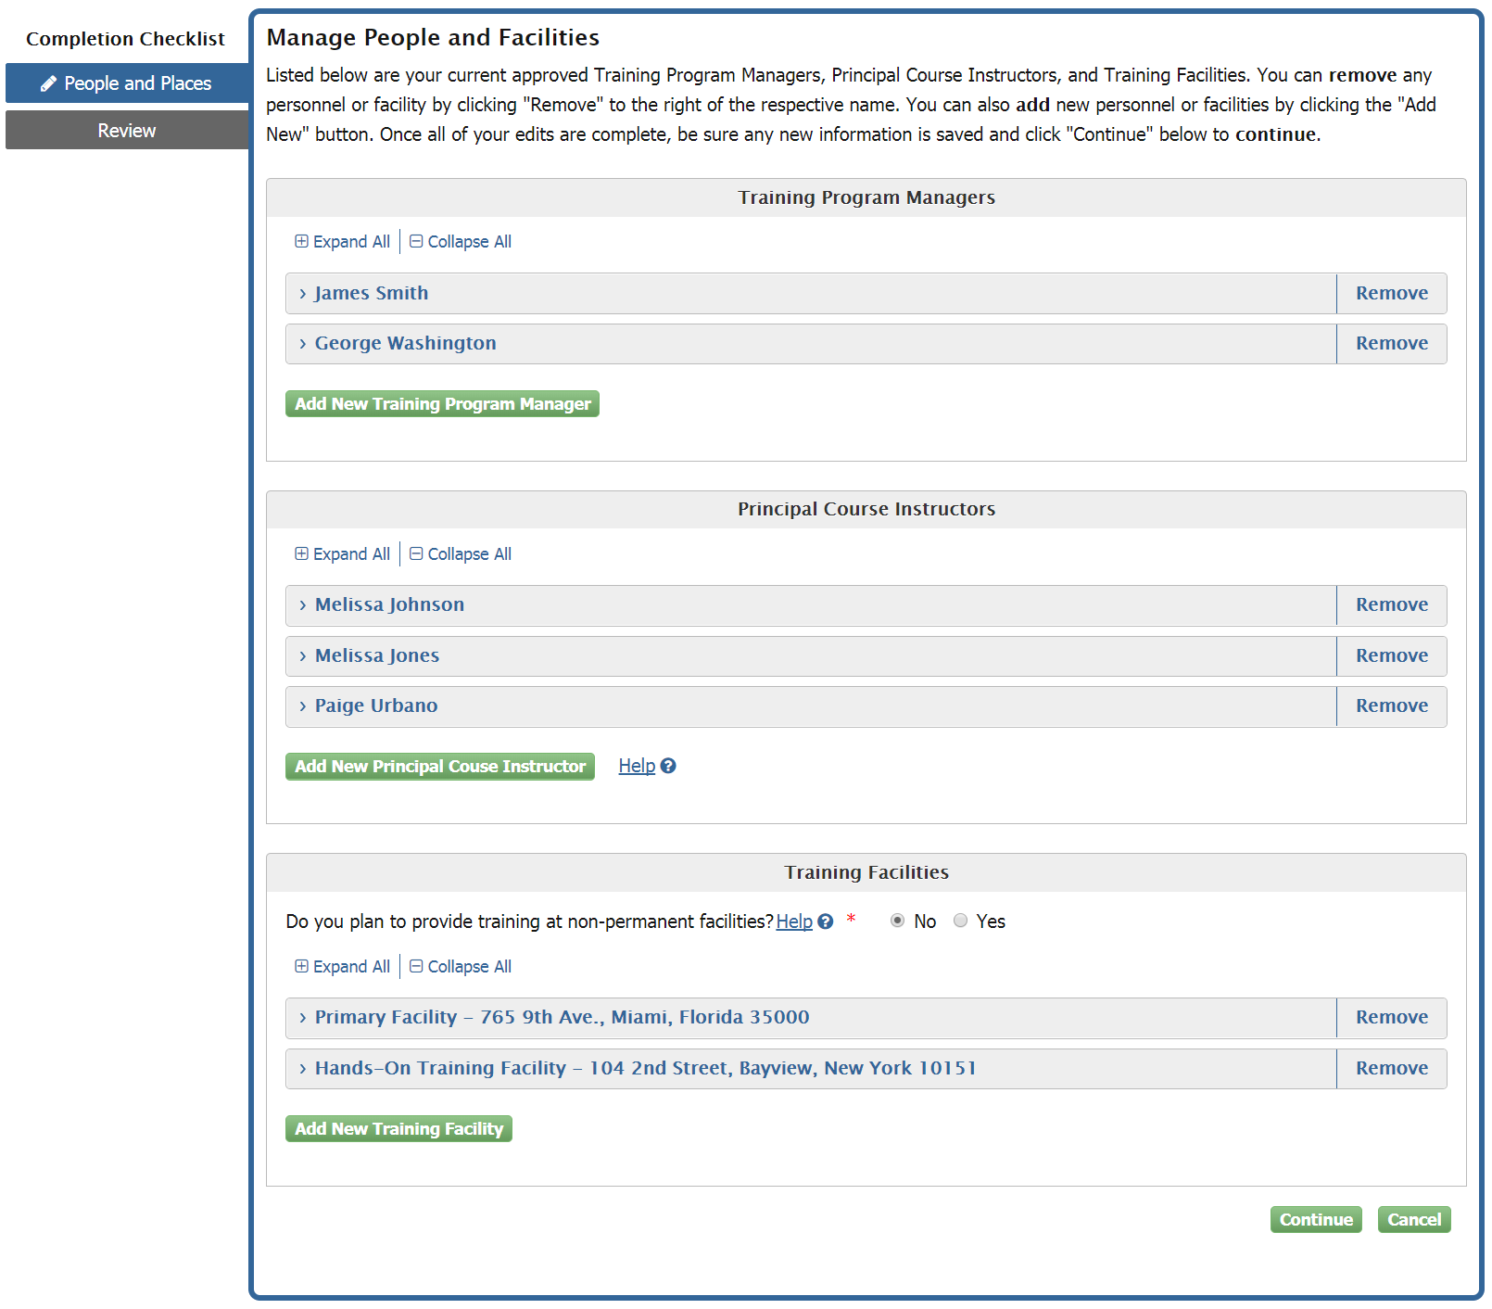
Manage People and Facilities
Notes:
Once on the "Manage People and Facilities" page users can add a new Training Program Manager by clicking the "Add New Training Program Manager" button or remove a Training Program Manager by clicking the "Remove" link next to the respective Manager. The user can perform similar actions for Principal Course Instructors and Training Facilities. Users can also choose whether they want to provide training at non-permanent facilities. In order to provide training at non-permanent facilities, users need to provide proper documentation, if they are not already accredited to do so.

Slide 12
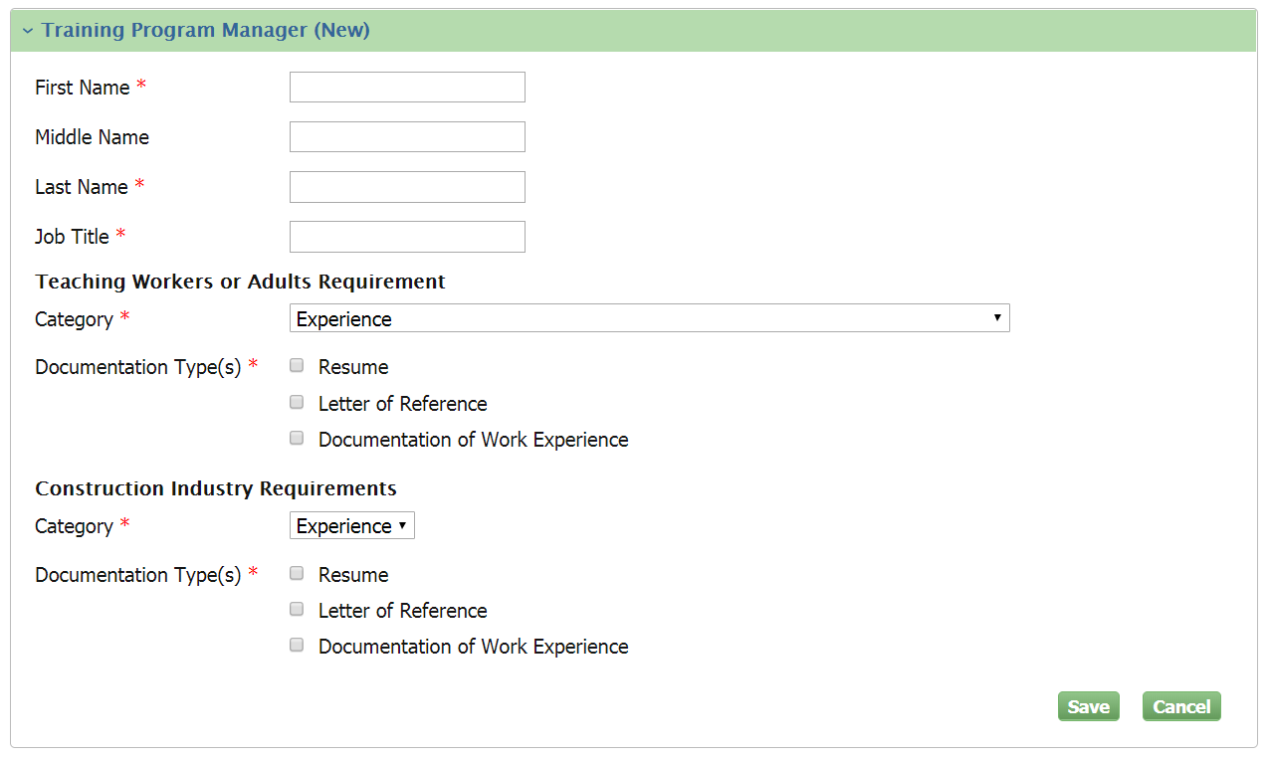
Manage People and Facilities
Notes:
Clicking the "Add New Training Program Manager" button will expand a new section with empty fields. "Documentation Type(s)" checkboxes will change with respect to which "Category" is chosen from the drop-down menu. At least one "Documentation Type(s)” must be checked per "Category." Checking a box will allow the user to upload the associated documentation. Uploaded documentation displays to the right of the respective checkbox. Users can view and/or remove uploaded documentation.

Slide 13
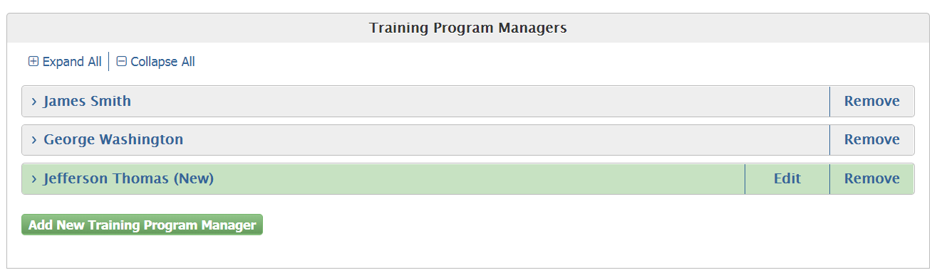
Manage People and Facilities
Notes:
Saving the "Training Program Manager" will collapse the section and display as shown. Users will have the ability to "Edit" the newly added "Training Program Manager" until the form is submitted. "Training Program Manager" information already submitted and processed will not be available for edit. To make changes to an existing "Training Program Manager," users will need to remove that "Training Program Manager" and submit a new amendment with new information.

Slide 14
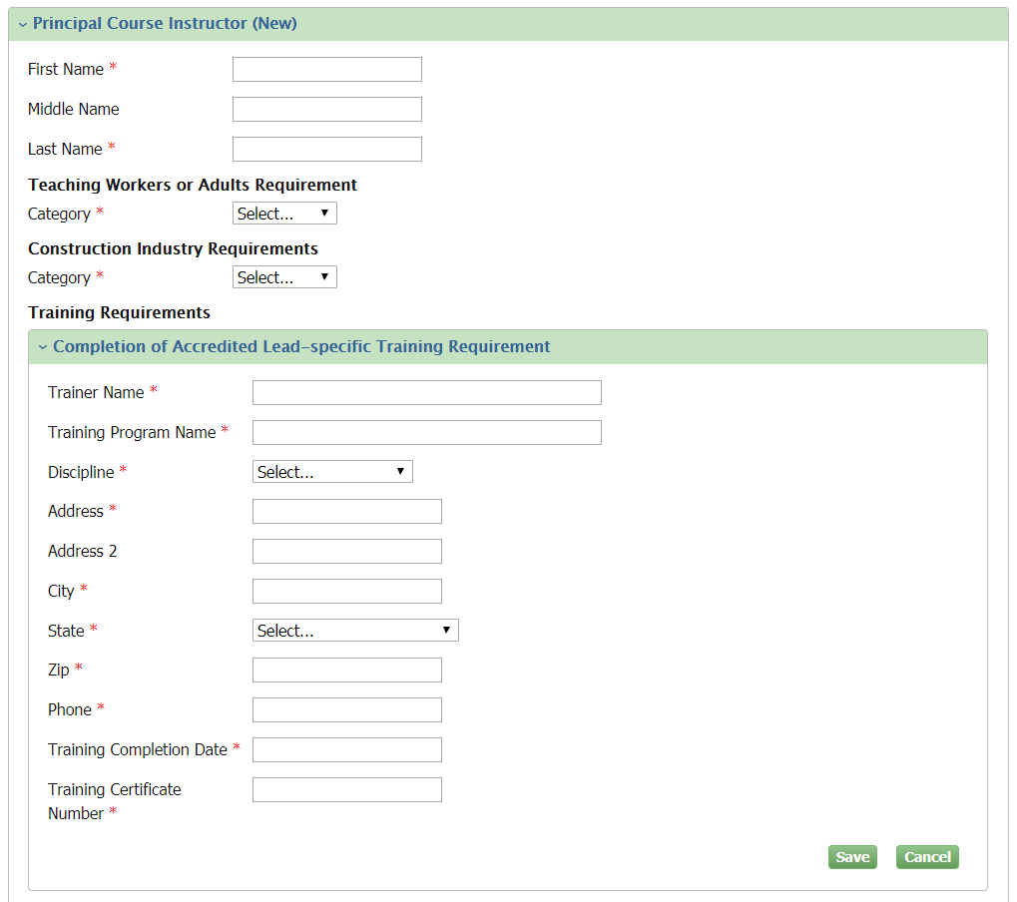
Manage People and Facilities
Notes:
Clicking the "Add New Principal Course Instructor" button will expand the "Principal Course Instructors" section and the "Training Requirements" sub-section with empty fields. Selecting "Categories," checking "Documentation Type(s),” and uploading documentation works the same as "Training Program Manager." A user can add/save multiple "Training Requirements" per "Principal Course Instructor."

Slide 15
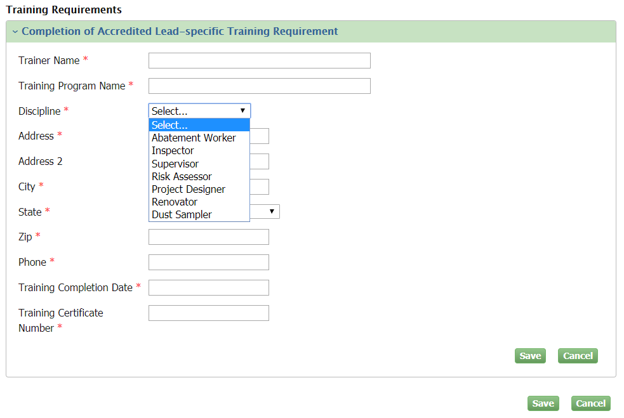
Manage People and Facilities
Notes:
When adding a "Training Requirement" for a "Principal Course Instructor,“ users will be able to select from multiple "Disciplines."

Slide 16
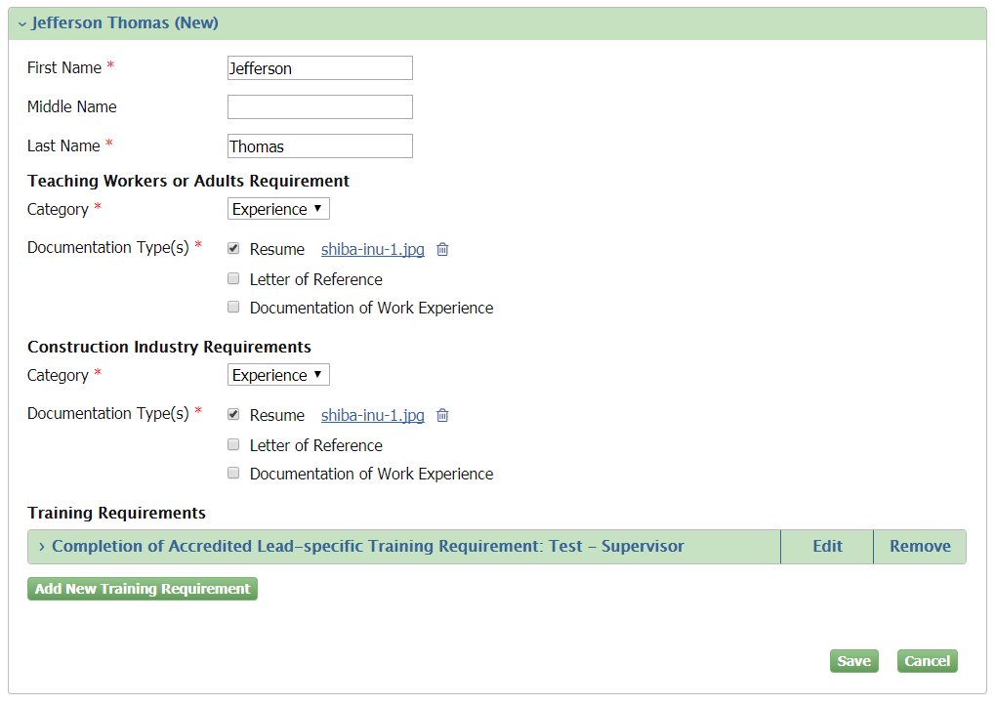
Manage People and Facilities
Notes:
Clicking "Save" within "Training Requirements" will collapse the "Completion of Accredited Lead-specific Training Requirement" section. The user can then edit, remove, or add another new training requirement for the "Principal Course Instructor."

Slide 17
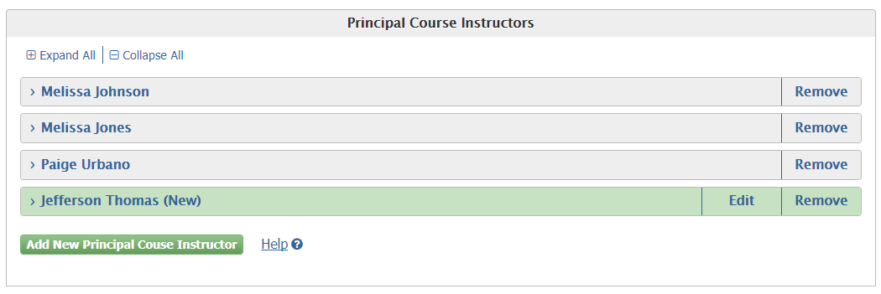
Manage People and Facilities
Notes:
Clicking "Save" within the "Principal Course Instructor" section will save the "Training Requirements" and all other information added for that "Principal Course Instructor." Saving the "Principal Course Instructor" will collapse the section and display as shown. Users will have the ability to edit the newly added "Principal Course Instructor" until the form is submitted. "Principal Course Instructor" information already submitted and processed will not be available for edit. To make changes to an existing "Principal Course Instructor" users will need to remove that "Principal Course Instructor" and submit a new amendment with new information.

Slide 18
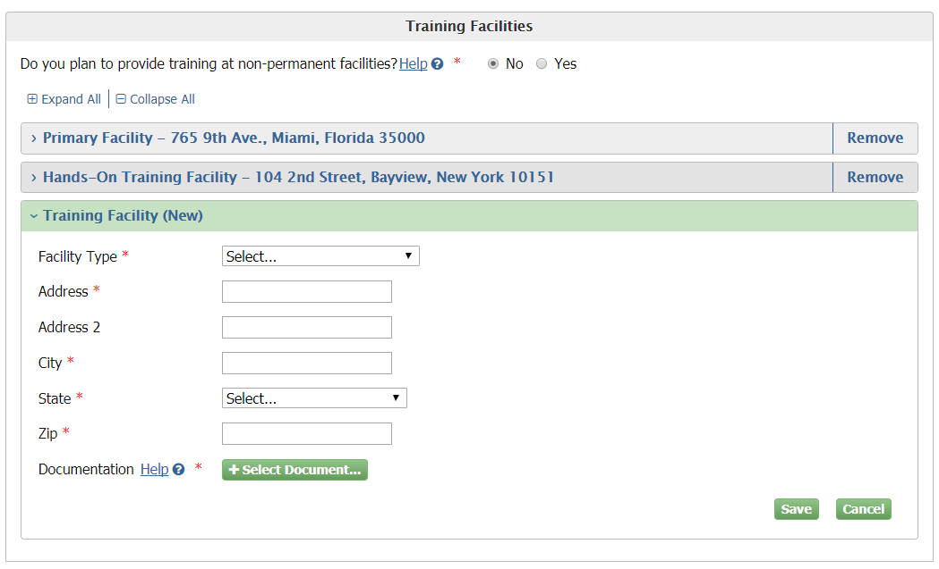
Manage People and Facilities
Notes:
Clicking the "Add New Training Facility" button will expand the "Training Facilities" section.

Slide 19
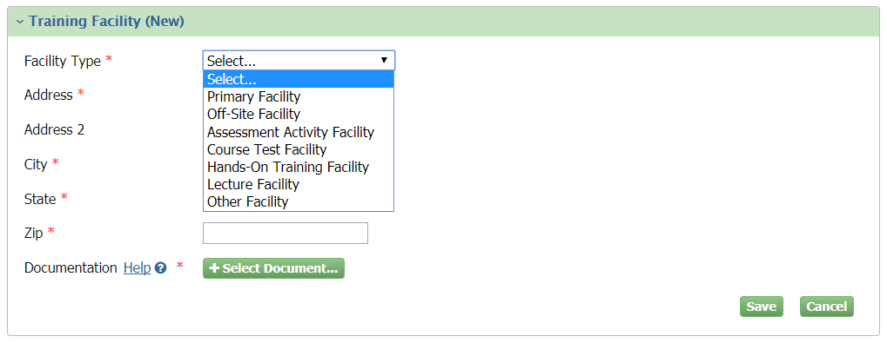
Manage People and Facilities
Notes:
Users have the ability to choose from multiple "Facility Types."

Slide 20
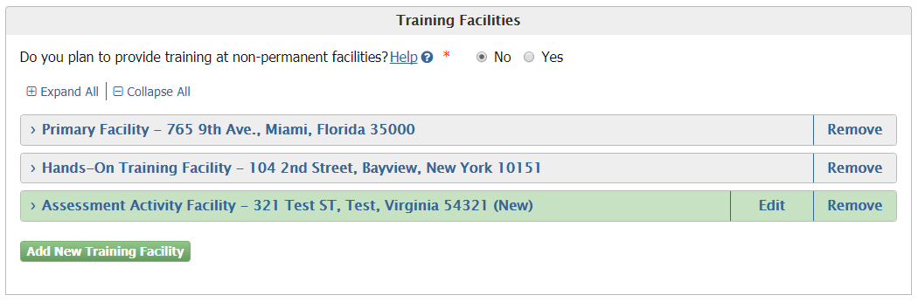
Manage People and Facilities
Notes:
Saving the "Training Facility" will collapse the section and display as shown. Users will have the ability to edit the newly added "Training Facility" until the form is submitted. Training Facility information already submitted and processed will not be available for edit. To change existing "Training Facilities" information, users will need to remove that Training Facility and submit a new amendment with new information.

Slide 21
Manage People and Facilities
Notes:
Clicking "Yes" for the "Do you plan to provide training at non-permanent facilities" button will allow the user to submit for accreditation to provide training at non-permanent facilities. The user will be required to upload supporting documentation. Providing information regarding non-permanent training facilities does not require adding "Training Facilities." Once "Non-permanent Training Facility" information is processed it cannot be unselected in future amendments.

Slide 22
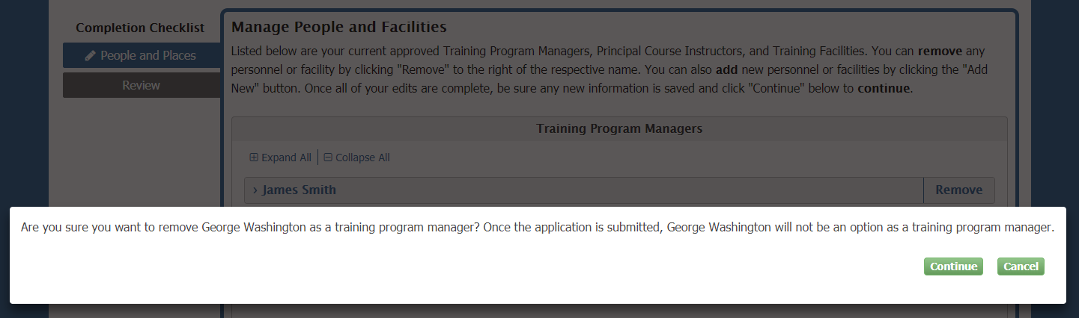
Manage People and Facilities
Notes:
Clicking "Remove" next to a current "Training Program Manager," "Principal Course Instructor," or "Training Facility" will remove that person or location following submission. Users are prompted to confirm the removal before continuing.

Slide 23
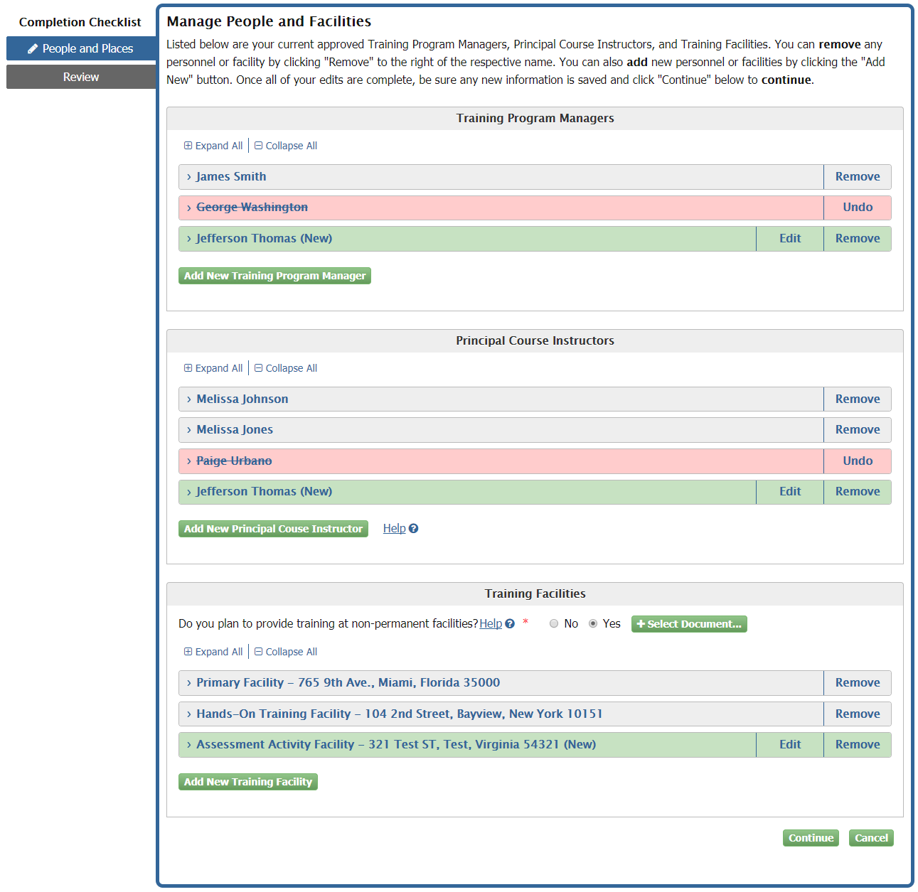
Manage People and Facilities
Notes:
Clicking "Remove" next to a current "Training Program Manager," "Principal Course Instructor," or "Training Facility" will remove that person or location following submission. Removed names will be display in a red field with a line through it. Users have the ability to "Undo" any removals before submitting the form by clicking the respective "Undo" button.

Slide 24
Manage People and Facilities
Notes:
Users must save all new additions prior to continuing to the "Manage People and Facilities - Review Page." Saved sections are collapsed.

Slide 25
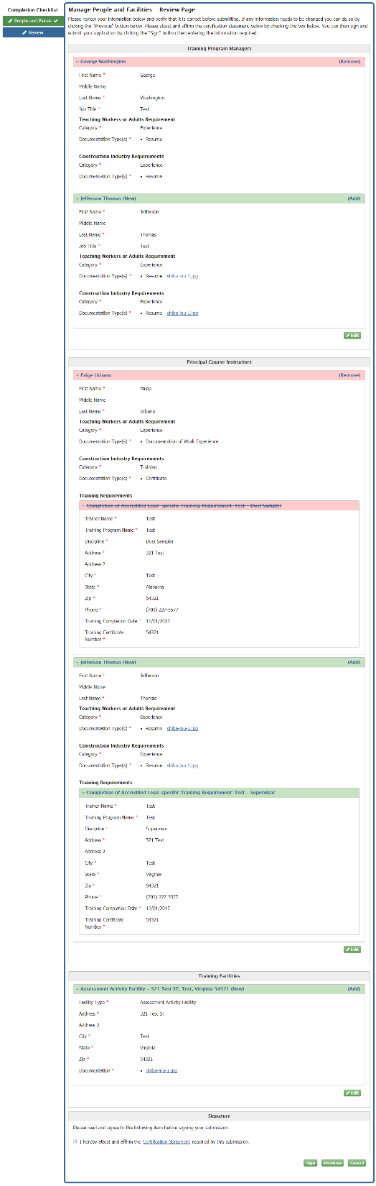
Manage People and Facilities – Review Page
Notes:
The review page will contain all additions/removals made on the edit page. Information that has not been added or removed will not appear on the review page.

Slide 26
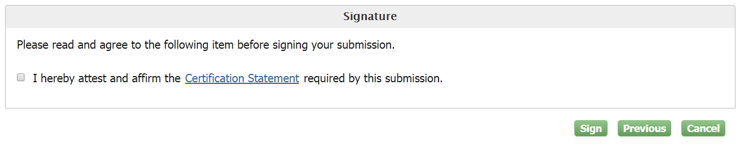
Manage People and Facilities – Review Page
Notes:
The "Signature" section at the bottom of the review page will allow users to click "Sign" and move forward with submitting the changes. Users can click "Previous" to move back to the edit page, or click "Cancel" to navigate back to the "Lead Training Provider Dashboard" without submitting any changes. All changes will be lost unless the application is signed and submitted. Users must check the box to affirm the "Certification Statement" before signing.

Slide 27
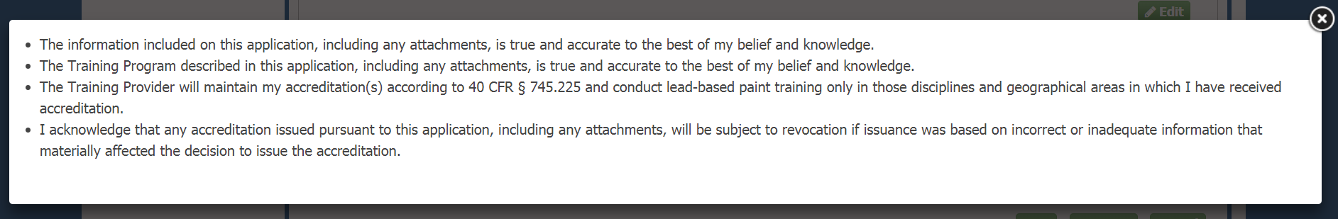
Manage People and Facilities – Review Page
Notes:
Clicking the "Certification Statement" link on the page will display the Certification Statement for the user to read.

Slide 28
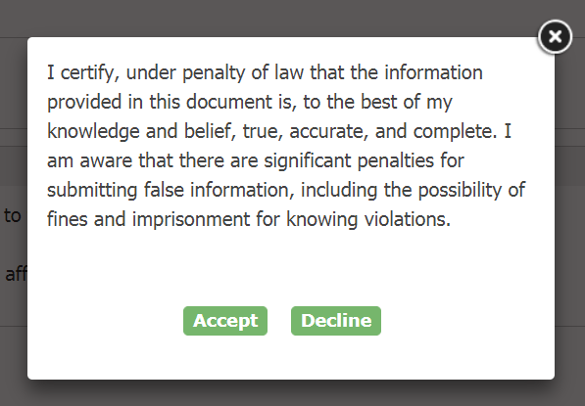
Manage People and Facilities – Review Page
Notes:
Checking the signature checkbox and clicking "Sign" will display the attestation clause for the user to certify the new changes. "Accept" displays the "eSignature Widget" for the user to electronically agree to and sign the form. "Decline" will direct the user back to the review page.

Slide 29
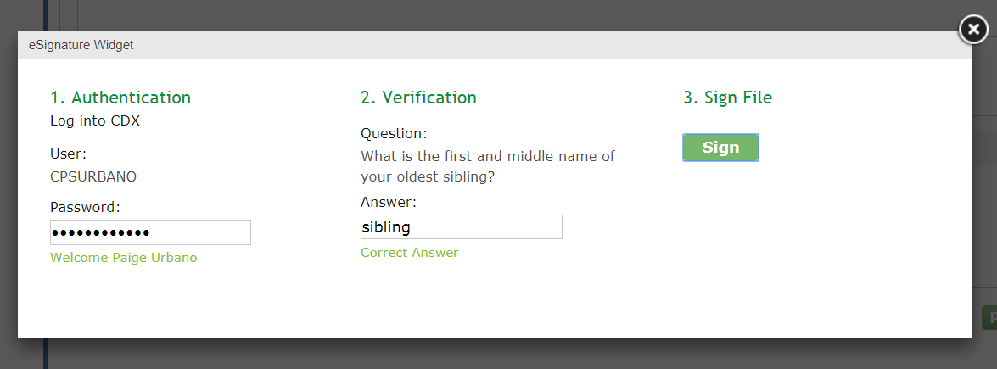
Manage People and Facilities – Review Page
Notes:
To complete signing and submitting the changes, the user will have to: Provide the correct CDX password for the account, answer the "Verification" security question correctly, and click "Sign" within the "eSignature Widget."

Slide 30
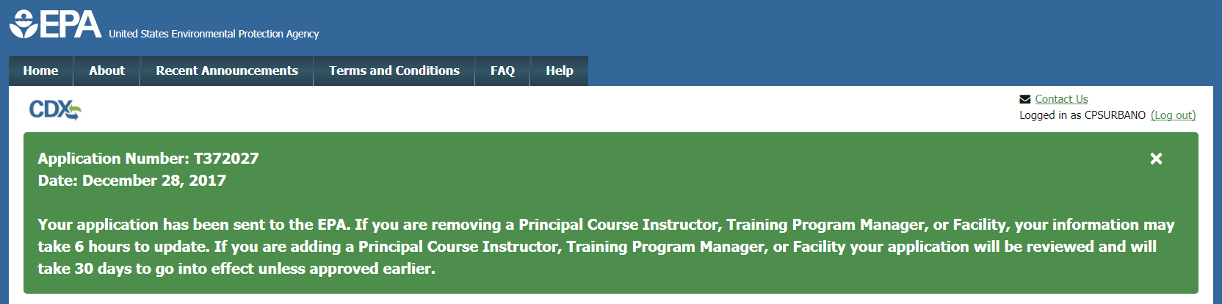
Application Submission Confirmation
Notes:
Once the application is signed and successfully submitted, confirmation of the submission will display on the "Lead Training Provider Dashboard" in a green field with the application number and the date of the submission.

Slide 31
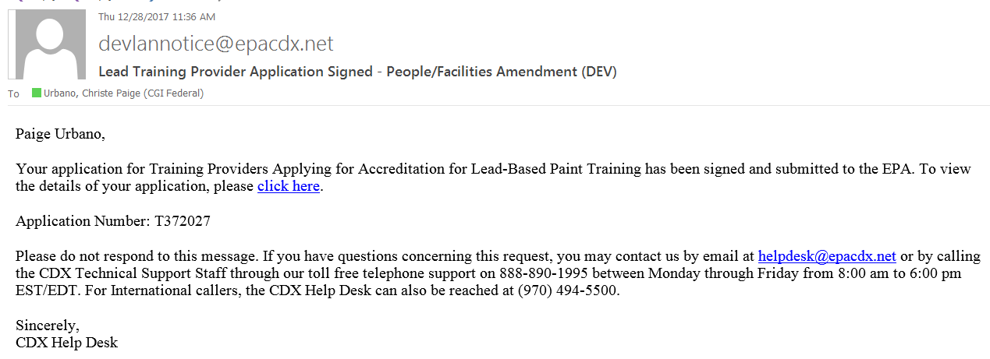
Application Submission
Notes:
A confirmation email containing the same information will also be sent to the email account associated with the user's CDX account.

Slide 32
Amendment – Information Only
Notes:
Users will be able to navigate to the "Amendment – Information Only" page from the dashboard by clicking the "Amendment – Information Only" tile.

Slide 33
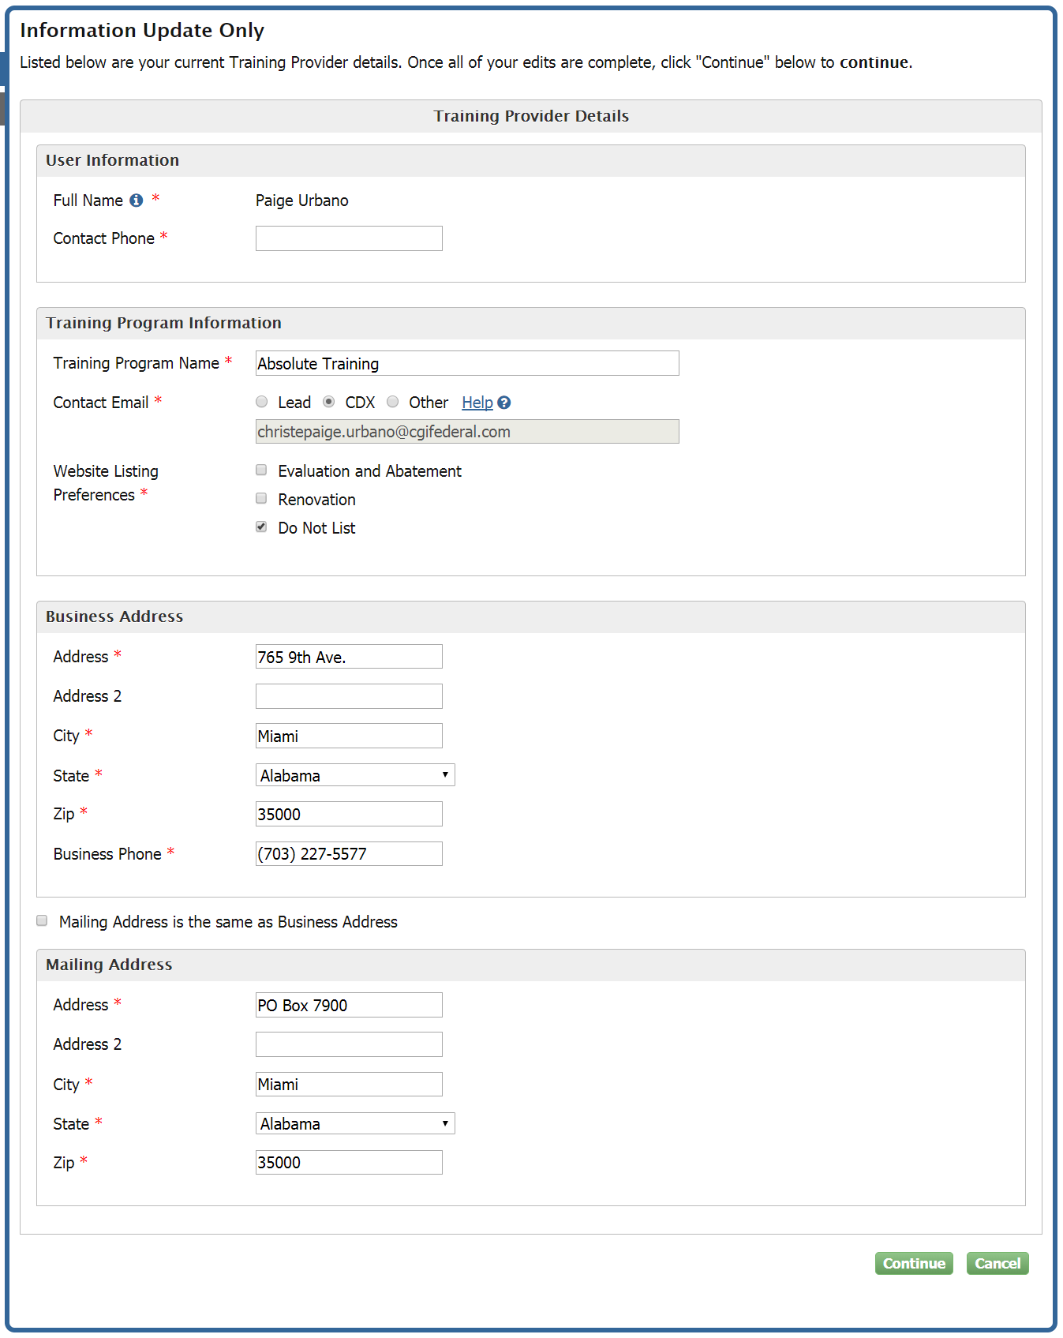
Amendment – Information Only
Notes:
After selecting "Amendment – Information Only" tab from the dashboard, users are directed to the "Information Update Only" page where they can: Update the "Training Program Name" and "Website Listing Preferences", as well as their contact information and Business Address.

Slide 34
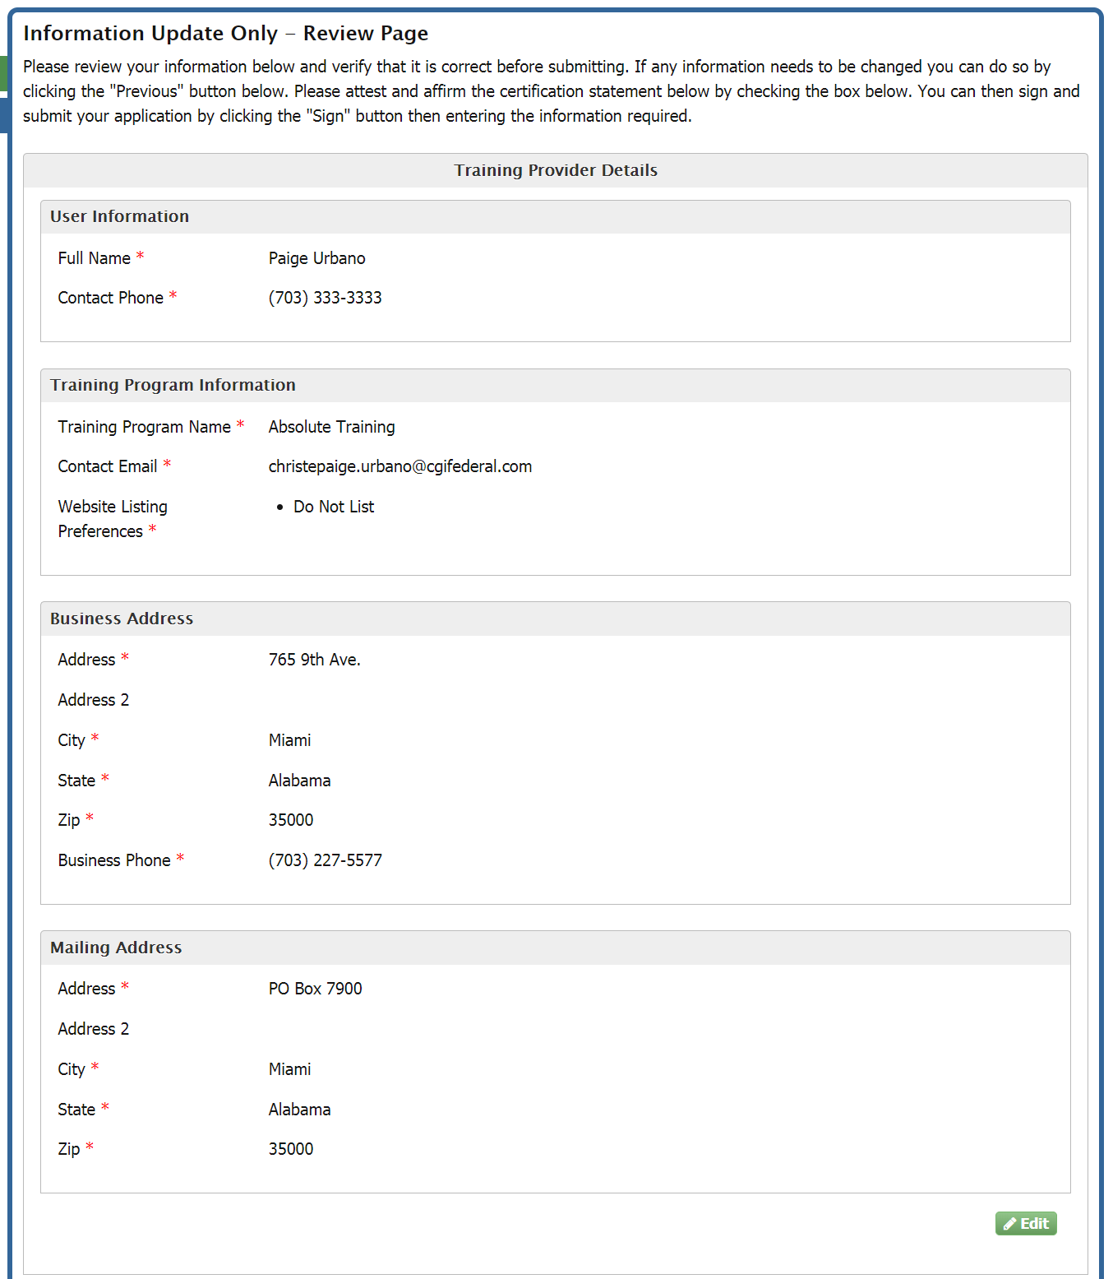
Amendment – Information Only – Review Page
Notes:
Clicking the "Continue" button will direct the user to the "Information Update Only – Review Page." This page provides the user the opportunity to review their "Training Provider Details" and make corrections if necessary.

Slide 35
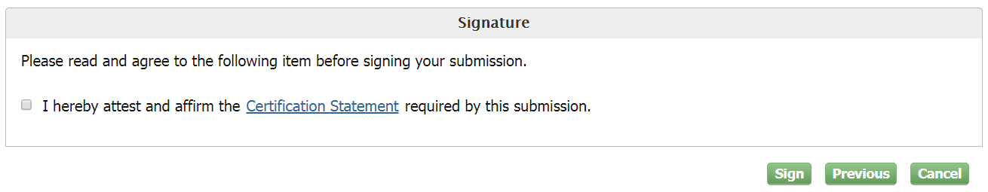
Amendment – Information Only – Review Page
Notes:
The "Signature" section at the bottom of the review page will allow users to click "Sign" and move forward with submitting the changes, click "Previous" and move back to the edit page, and click "Cancel" to navigate back to the "Lead Training Provider Dashboard" without submitting any changes. All changes will be lost unless the application is signed and submitted. Users must check the box to affirm the "Certification Statement" before signing.

Slide 36
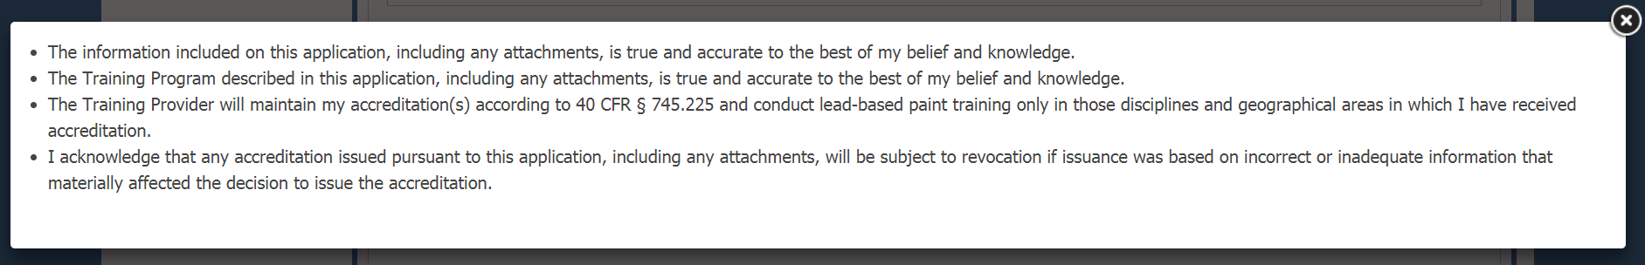
Amendment – Information Only – Review Page
Notes:
Clicking the "Certification Statement" link on the page will display the Certification Statement for the user to read.

Slide 37
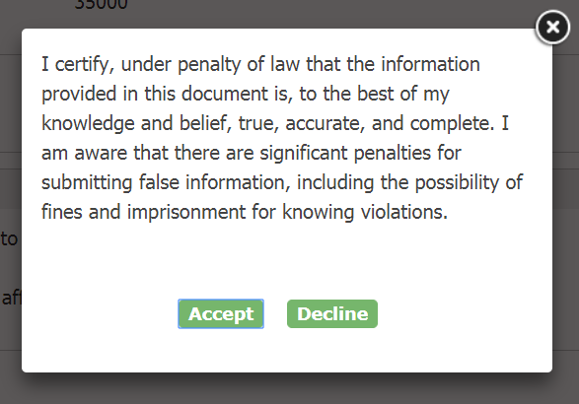
Amendment – Information Only – Review Page
Notes:
Checking the signature checkbox and clicking "Sign" will display the attestation clause for the user to certify the new changes. "Accept" displays the "eSignature Widget" for the user to electronically agree to and sign the form. "Decline" will direct the user back to the review page.

Slide 38
Amendment – Information Only – Review Page
Notes:
To complete signing and submitting the changes, the user will have to: Provide the correct CDX password for the account, answer the "Verification" security question correctly, and click "Sign" within the "eSignature Widget."

Slide 39
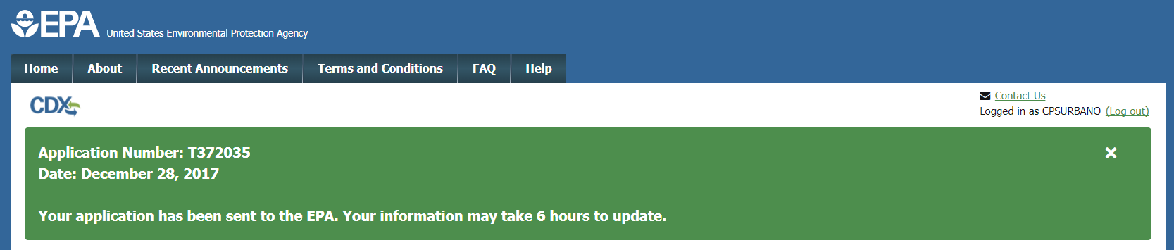
Application Submission Confirmation
Notes:
Once the application is signed and successfully submitted, confirmation of the submission will display on the "Lead Training Provider Dashboard" in a green field with the application number and the date of the submission.

Slide 40
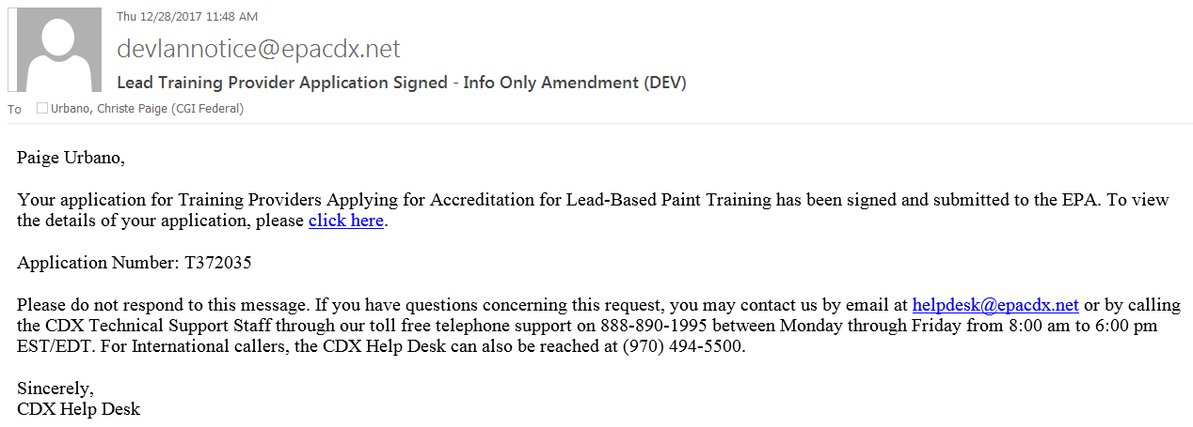
Application Submission
Notes:
A confirmation email containing the same information will also be sent to the email account associated with the user's CDX account.

Slide 41
Manage Course Accreditations
Notes:
Reaccreditation of current courses, renewal of expired courses, and adding new courses is done within the "Manage Course Accreditations" tile.

Slide 42
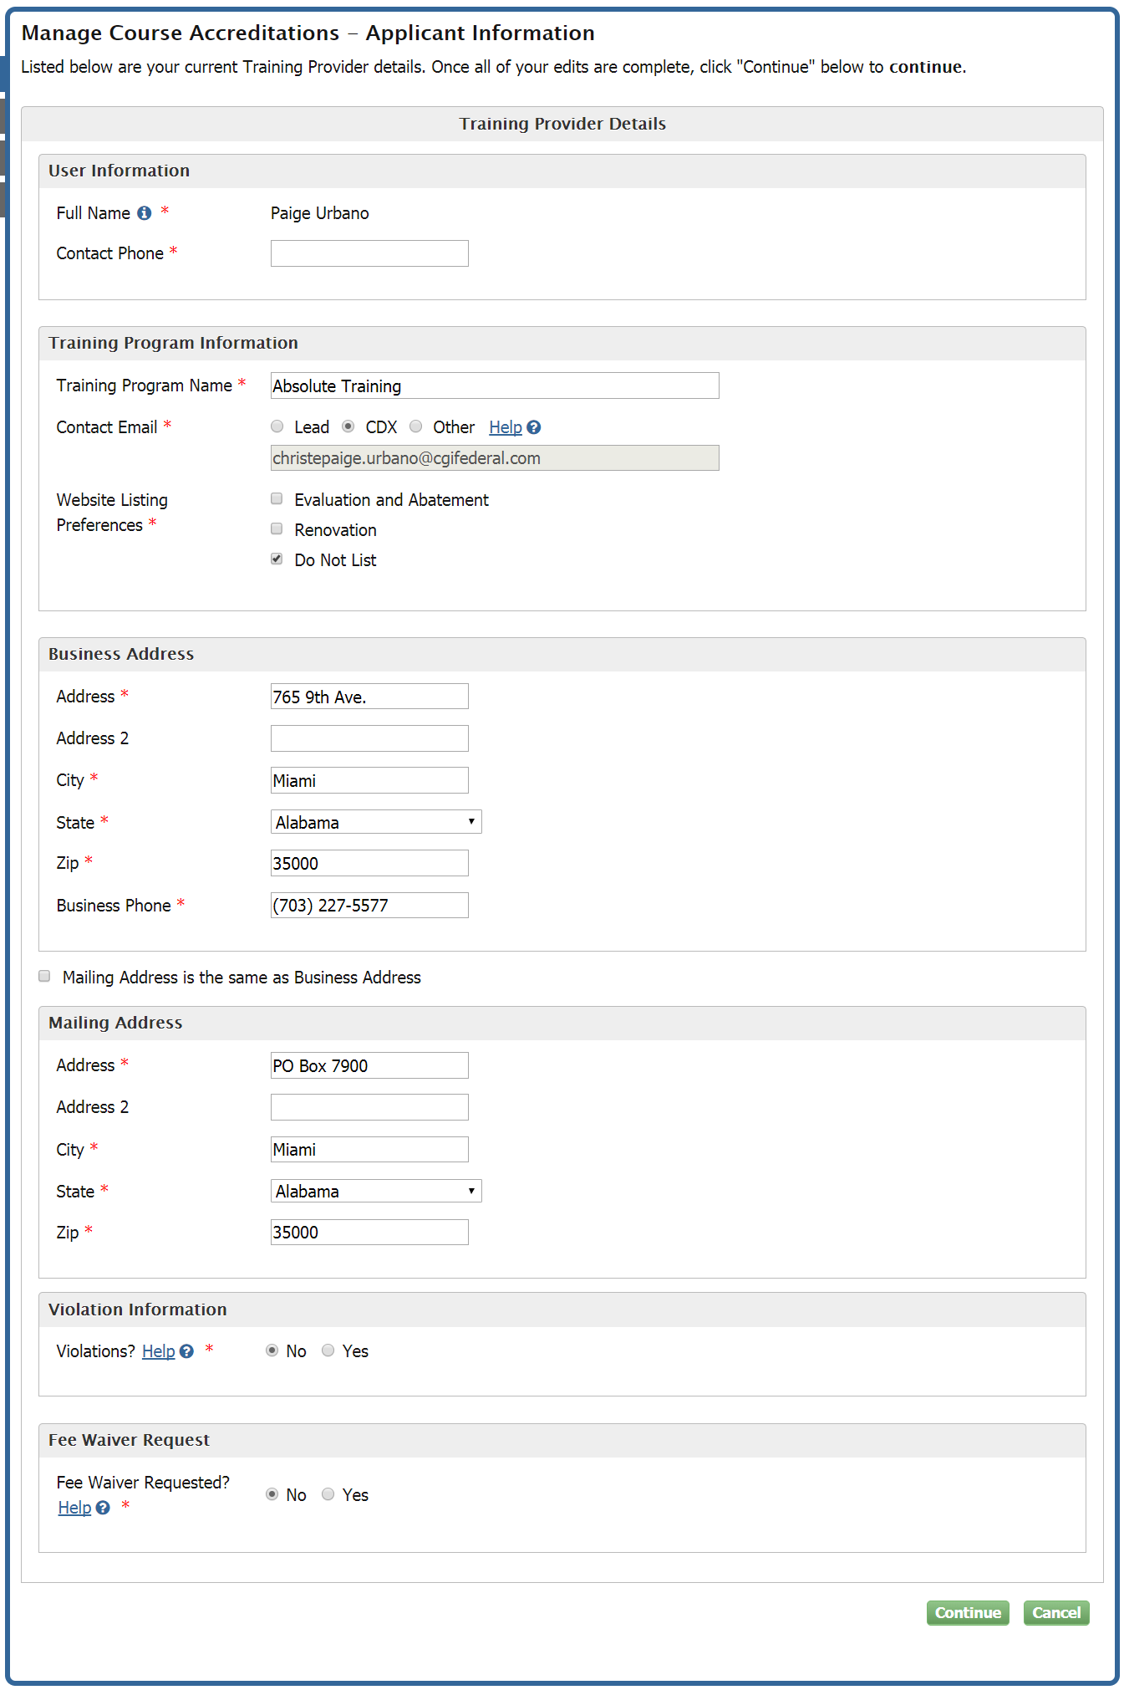
Manage Course Accreditations- Applicant Information
Notes:
Users will also have an opportunity to update any existing information associated with their certification during this process. It is important to note that the user's email confirmation will be sent to the email address selected from the “Contact Email” on the “Applicant Information” screen. Users can click Continue to move to next “Accreditation Info” , however they have to fill the Contact Phone again.

Slide 43
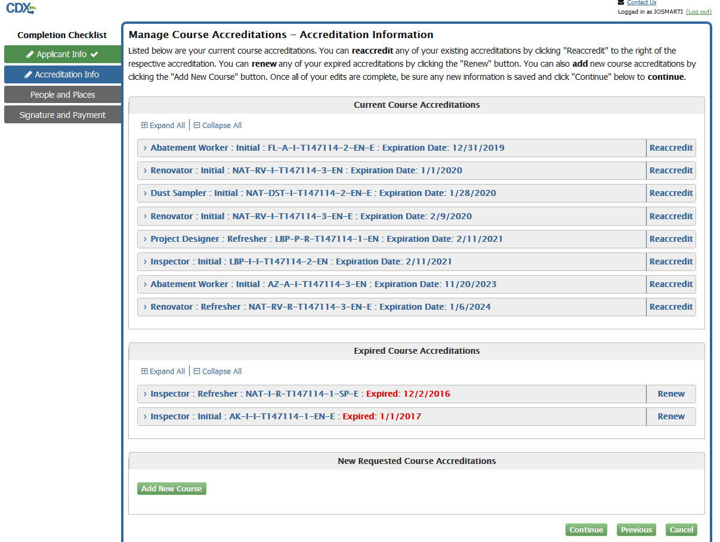
Manage Course Accreditations- Accreditation Information
Notes:
On the “Accreditation Information” screen, users are able to reaccredit an existing course accreditation, renew an expired accreditation or request a new course accreditation. Users are required to perform at least one of these actions in order to be able to continue with the application process.

Slide 44
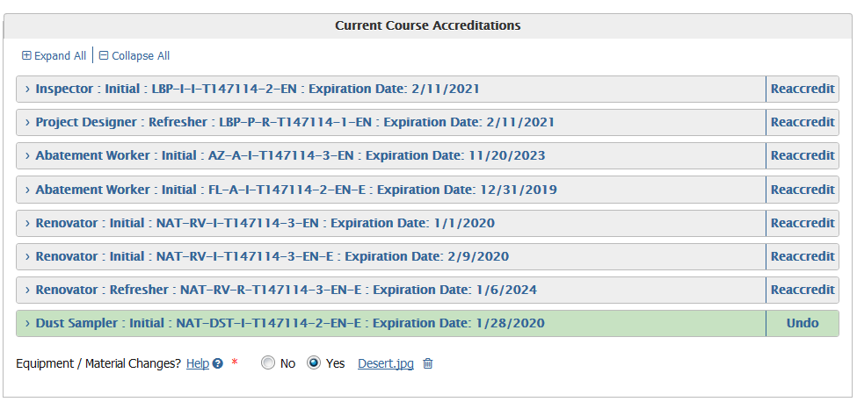
Manage Course Accreditations- Current Course Accreditations
Notes:
Users will be able to reaccredit an existing, non-expired course accreditation in the “Current Course Accreditations” section. If any changes have been made regarding facility, equipment, or course materials since the last application approval, they will need to upload documentation describing those changes; particularly changes that may adversely affect a student's ability to learn.

Slide 45
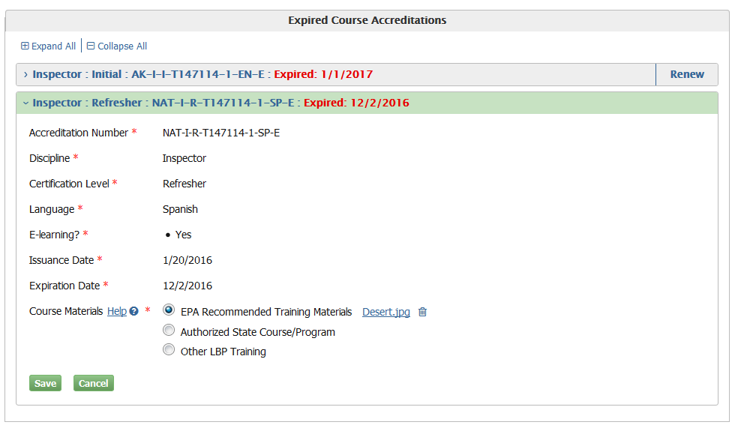
Manage Course Accreditations- Expired Course Accreditations
Notes:
If the user has any expired courses, they will appear in the “Expired Course Accreditations” sections. Renewing an expired notification costs the same as applying for new course accreditation for the same course. Renewing an expired accreditation requires that the user upload respective course materials. The user will not be allowed to renew an expired course if they have a current course of the same type.

Slide 46
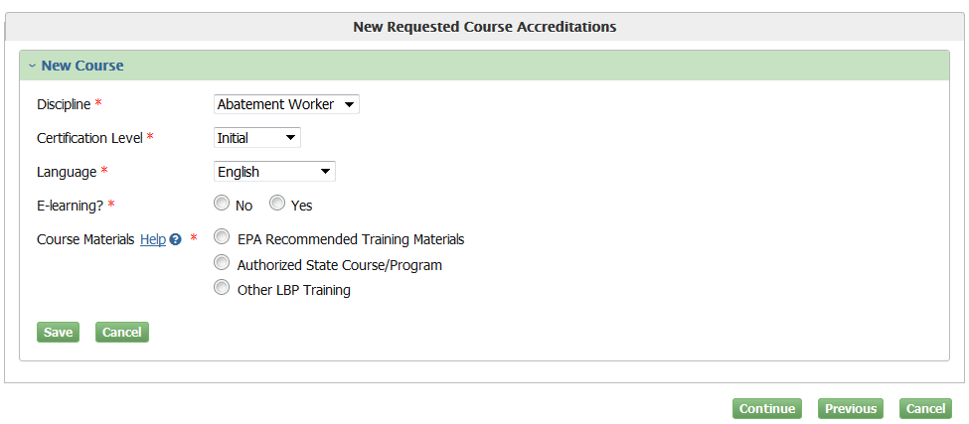
Manage Course Accreditations- New Course Accreditations
Notes:
Users will be able to add new courses in the “New Requested Course Accreditation” section. If the user has an existing certification they will have the ability to add new course accreditations. Adding a new course will require the upload of course materials, similar to renewing expired courses. If the user already has a similar course in current or expired accreditations the user will not be able to duplicate that course when requesting a new accreditation.

Slide 47
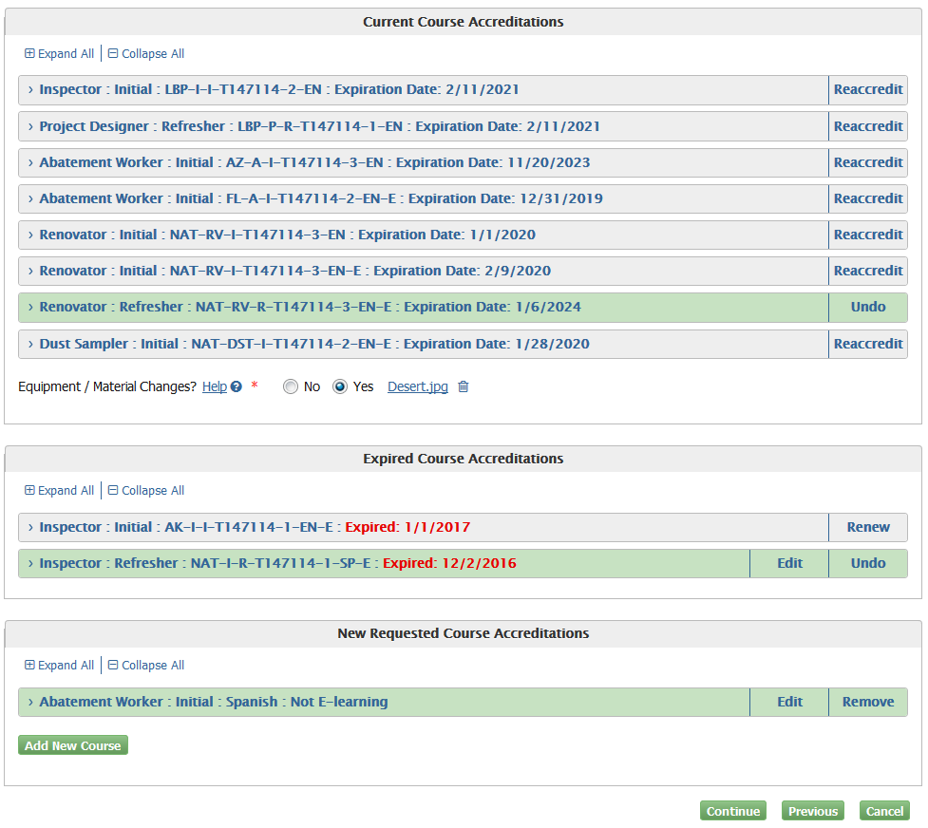
Manage Course Accreditations- Accreditation Information
Notes:
Users can submit all three accreditation application types. If they want to undo submission of one or more of the applications they can simply click the "Undo" button to the right of the respective accreditation. The user is required to submit at least one of the application types.

Slide 48
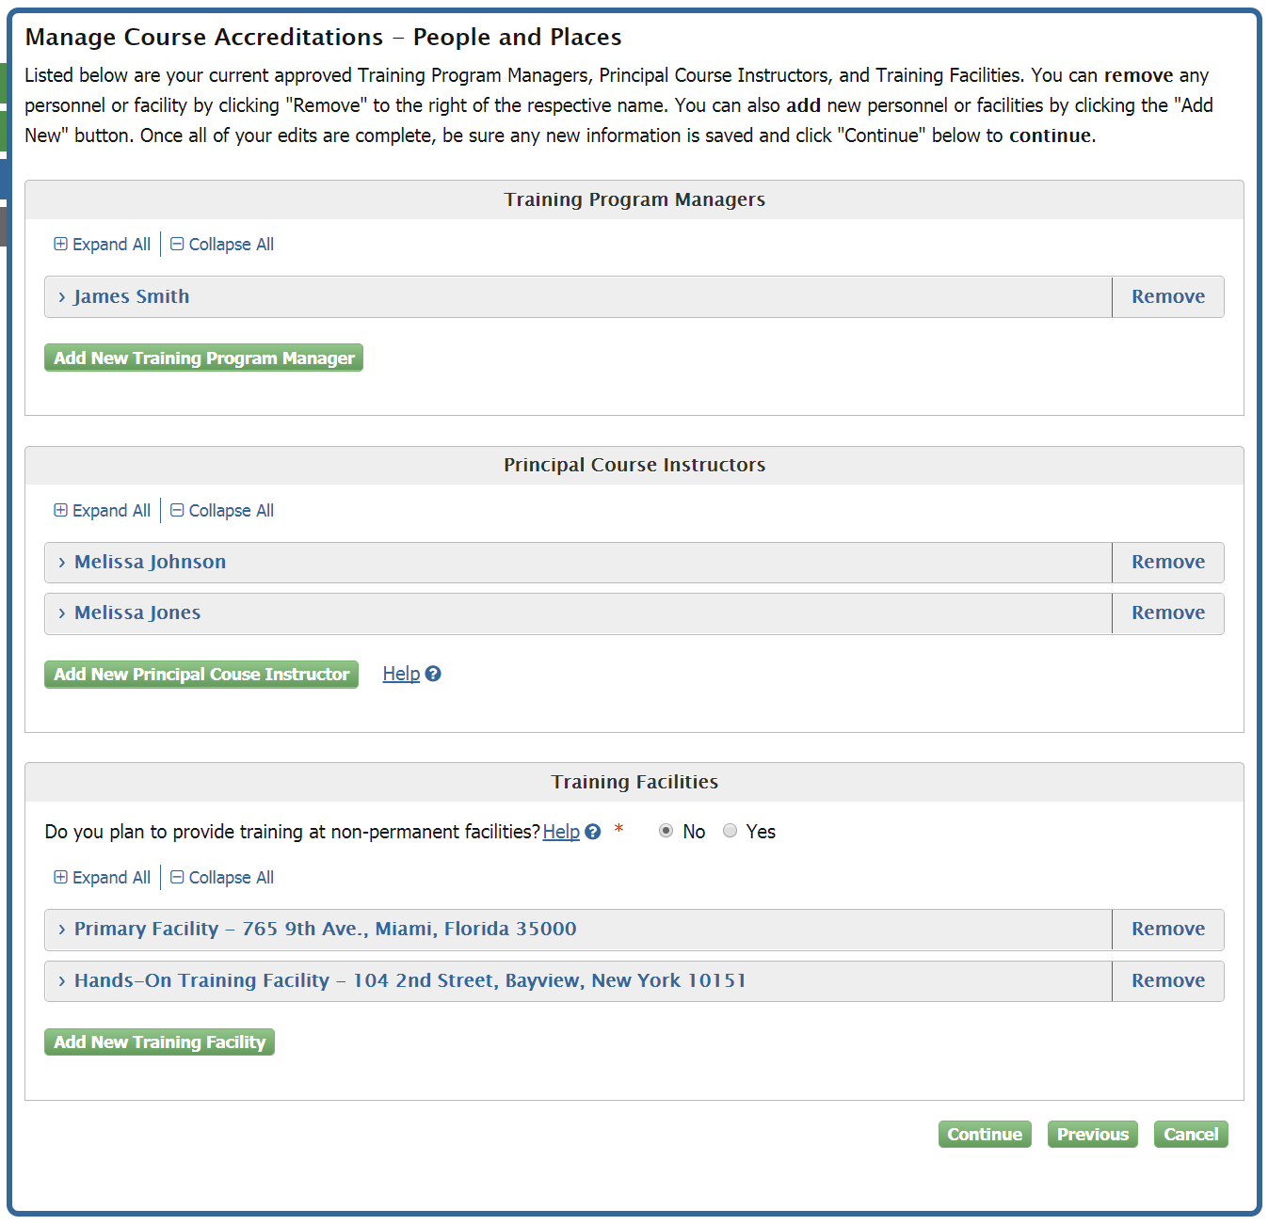
Manage Course Accreditations- People and Places
Notes:
The “People and Places” screen will act the same as the “Manage People and Facilities” amendments application. However, here users will not be required to make any changes to “People and Places” unless they have not provided at least one Training Program Manager, Principal Course Instructor, or Training Facility. Users are required to have at least one of each in order to proceed. Selecting "Yes" and providing proper documentation for non-permanent training facilities is also acceptable to meet the minimum for Training Facilities.

Slide 49
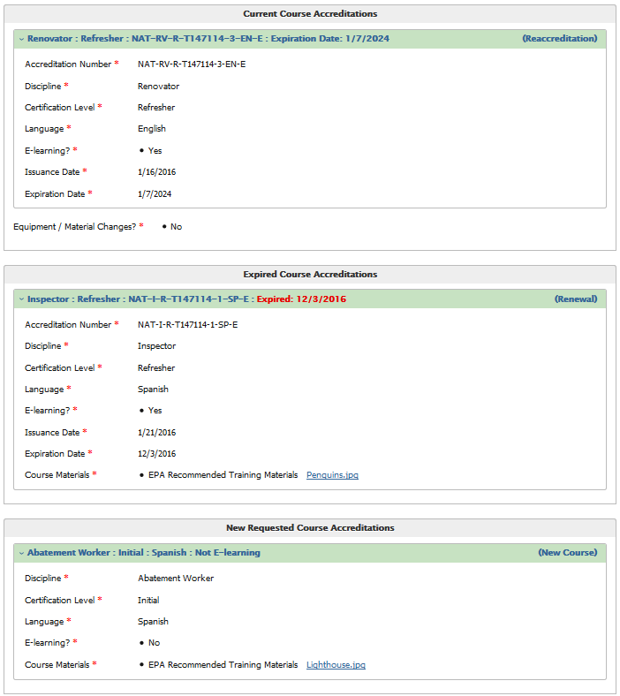
Manage Course Accreditations- Signature and Payment
Notes:
The user can review all of their edits on the Review and Payment Page.

Slide 50
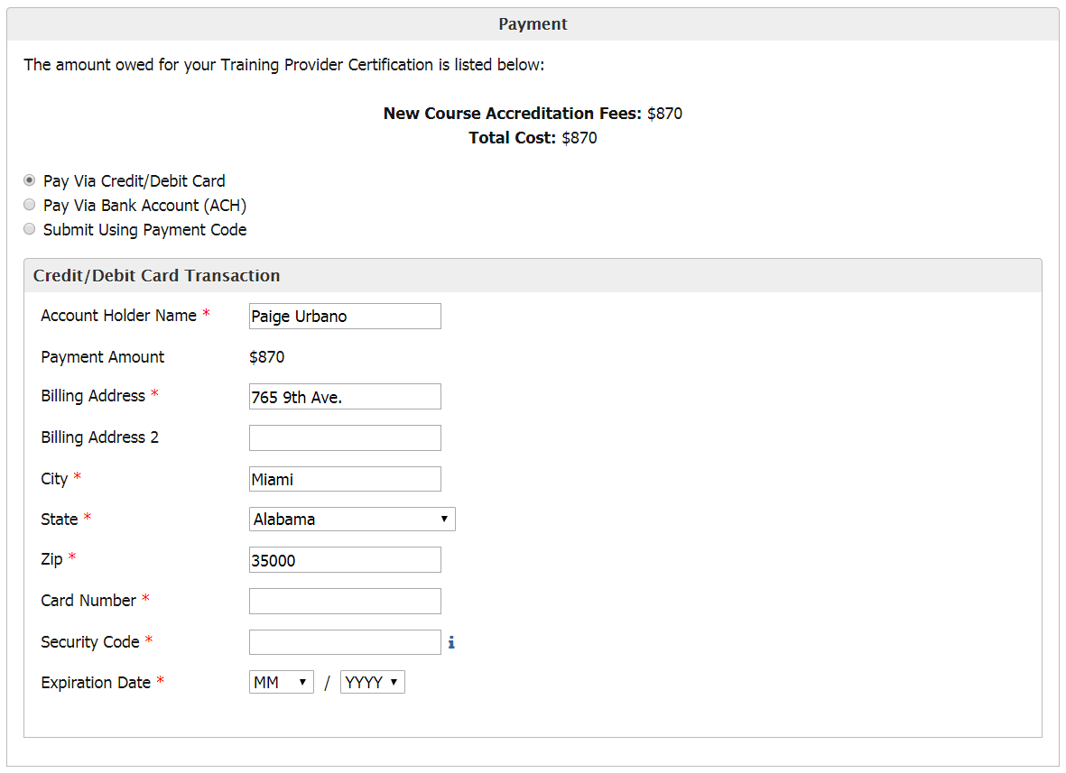
Manage Course Accreditations- Signature and Payment
Notes:
Users are assessed fees for changes or additions of accreditations for the entire application. New and expired-renewal accreditations are assessed NEW course accreditation fees per the fee schedule. Course reaccreditations of current, non-expired courses are assessed reaccreditation fees per the fee schedule. Users can make payment using credit/debit card, bank account(ACH) or payment code provided by their company.

Slide 51
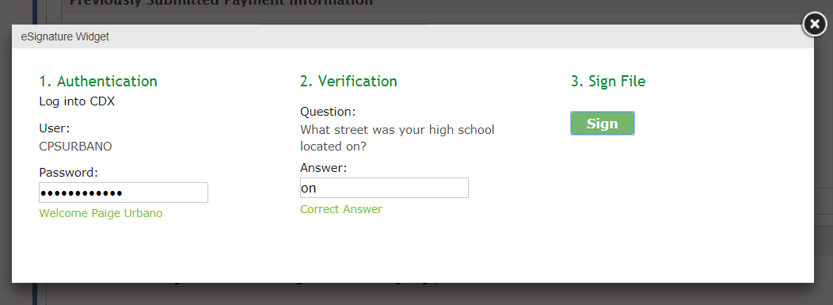
Manage Course Accreditations- Signature and Payment
Notes:
Users will sign and finish paying for their application by entering their CDX password and clicking "Submit."

Slide 52
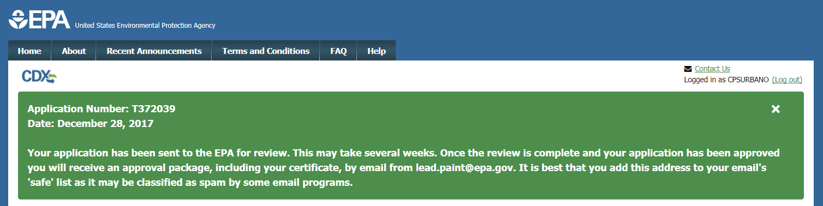
Manage Course Accreditations- Submission Confirmation
Notes:
After successfully signing and paying for their application, users will be sent back to the "Lead Training Provider Dashboard" home page where their newly generated application number will be displayed along with the date the application for accreditation was submitted. A subsequent email confirmation with receipt will be sent to the user's chosen “Contact Email” address from the “Applicant Information” screen.

Slide 53
Certificate Replacement Request
Notes:
Users will have the ability to request replacements for any lost or misplaced certificates using the "Certificate Replacement Request" tile.

Slide 54
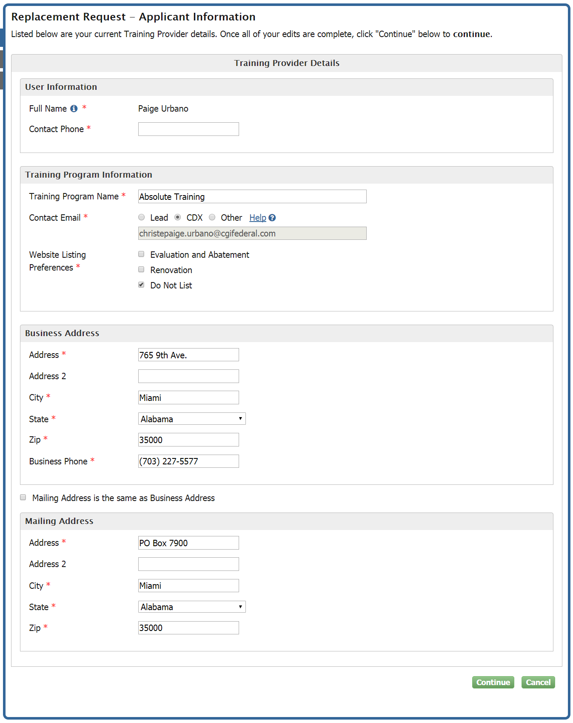
Replacement Request - Applicant Information
Notes:
Prior to completing the request for certificate replacement, users have the option to change or update any information on the replacement certificate using the ”Applicant Information” screen.

Slide 55
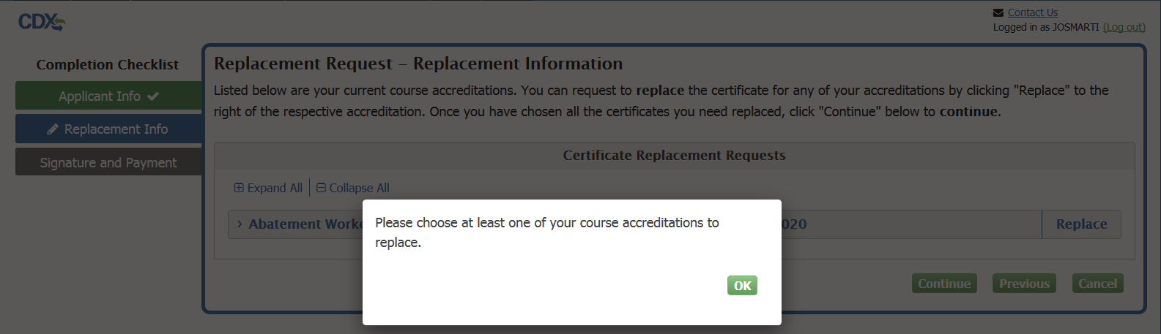
Replacement Request - Replacement Information
Notes:
Expired course accreditations are not eligible for replacement. Users must select at least one current, non-expired course accreditation certificate to replace before continuing with the application.

Slide 56
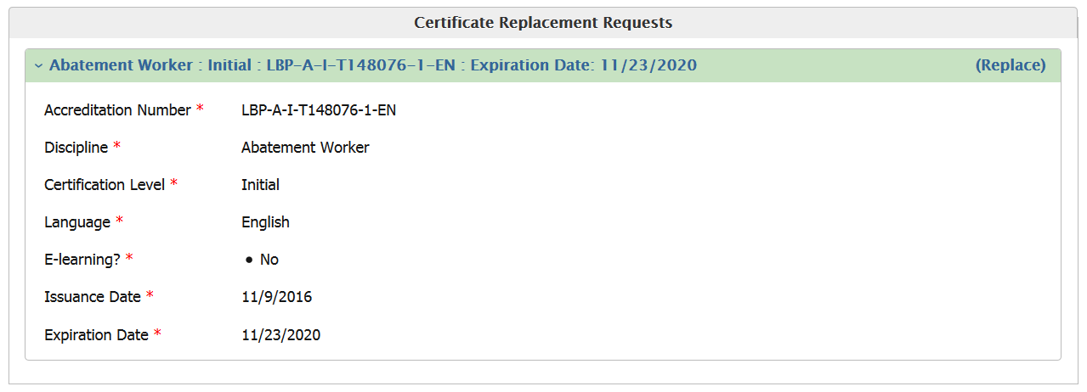
Replacement Request - Review
Notes:
All certificate replacement requests and any other changes made during form submission will be reviewable from the “Signature and Payment” screen.

Slide 57

Replacement Request - Signature and Payment
Notes:
Users will be charged $15.00 per certificate replacement request. There are no added charges for changing information during form submission as any changes are treated as amendments to the certificate.

Slide 58
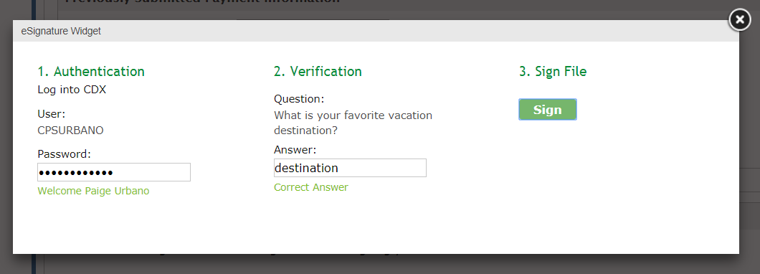
Replacement Request - Signature and Payment
Notes:
Users will sign and finish paying for their application by entering their CDX password and clicking "Submit."

Slide 59
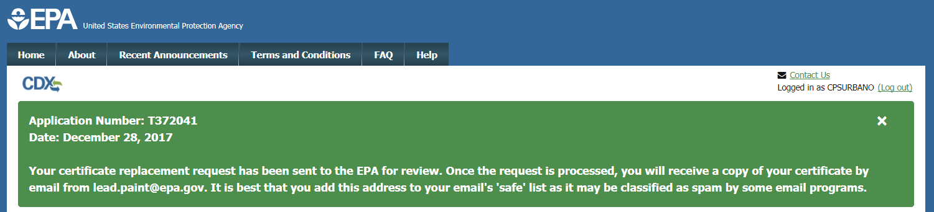
Replacement Request- Submission Confirmation
Notes:
After successfully signing and paying for their application, users will be sent back to the "Lead Training Provider Dashboard" home page where their newly generated application number will be displayed along with the date the application for replacement was submitted. A subsequent email confirmation with receipt will be sent to the user's chosen “Contact Email” address from the “Applicant Information” screen.

Slide 60
CDX Inbox
Notes:
Users will now have access to their CDX Inbox directly from the "Lead Training Provider Dashboard."

Slide 61

CDX Inbox
Notes:
Here users will be able to view any of their inbox messages just as they had navigated to their inbox from the “MyCDX” home screen.

Slide 62

Adding a Preparer to an existing Training Program
Notes:
Preparers must be added by the Training Program Manager through the “Manage Preparers and Submissions” tile on the Training Provider dashboard.

Slide 63

Adding a Preparer to an existing Training Program
Notes:
Users will have to click “Add Preparer” in order to add a preparer.

Slide 64

Adding a Preparer to an existing Training Program
Notes:
Enter the preparer’s name in the fields on the “Add a Preparer” page.

Slide 65

Adding a Preparer to an existing Training Program
Notes:
When a preparer is added their name will show up in the Preparers table. After a preparer’s name is added to the Preparers table, the preparer is able to register for a CDX account through the Training Provider public site. Please reference the Training Provider Preparer Role User Guide for step-by-step guidance to setup a Preparer's CDX account.

Slide 66

Reviewing Preparer submissions
Notes:
The Training Program Manager’s dashboard is also limited when the preparer submits a people and facilities amendment, course accreditation application, certificate replacement request, or info only amendment. The manager will need to sign these pending submissions by accessing them through the “Manage Preparers and Submissions” tile.

Slide 67

Reviewing Preparer submissions
Notes:
All pending submissions are listed in the “Pending Submissions” table on the “Preparer and Submission Management Home” page. The training program manager can click “Review” to review and sign a submission or “Delete” to delete a submission. Pending submissions on this table are not sent to EPA until reviewed and signed by the training program manager.

Slide 68


Reviewing Preparer submissions
Notes:
Clicking “Review” on a notification submission brings the program manager to the “Review Pre-Training Notification” page. Here the manager can review information submitted by the preparer and sign notifications to submit to EPA.

Slide 69

Reviewing Preparer submissions
Notes:
The Training Program Manager will see this message to confirm that the notification has been successfully submitted.

Slide 70


Reviewing Preparer submissions
Notes:
Submissions that require payment information will open to the “Review and Payment” page. Here the manager can review information submitted by the preparer, add payment information, sign, and submit to EPA. Preparers do not have the ability to add payment information on the preparer dashboard, so payment information must always be added by the Training Program Manager during review.

Slide 71

Reviewing Preparer submissions
Notes:
The Training Program Manager will see this message to confirm that the application has been successfully submitted.

Slide 72

Deactivating Preparer’s Dashboard
Notes:
If for any reason the Training Program Manager needs to disable a preparer’s dashboard, they can do this by clicking “Deactivate” next to the preparer’s name on the “Preparer and Submission Management Home” page.

Slide 73

Deactivating Preparer’s Dashboard
Notes:
A preparer whose dashboard has been deactivated will be redirected to the public site and see this message when they try to access their dashboard. A preparer’s dashboard may also be reactivated any time by clicking the “Reactivate” button next to their name on the “Preparer and Submission Management Home” page.

Slide 74

Expired Accreditations - Dashboard
Notes:
If a user has no valid accreditations, they will only be allowed limited access to the dashboard. They will only have access to the Inbox, Notifications, Manage Preparers and Submissions, and Manage Course Accreditations tiles.

Slide 75

Expired Accreditations – Accreditation Information
Notes:
If a user has no valid accreditations, they will only have the options to reaccredit expired courses or add new courses which will be charged the NEW accreditation fee.

Slide 76

Calendar and To Do List
Notes:
The "To Do List" displays the 5 most urgent actions that the training program needs to complete with respect to post-training notification due dates and renewing accreditation expiration dates. The "To Do List" displays actions from one week prior to six months from the current date. Post-Training Notifications are due 10 business days after Training. Renovator, Refresher, E-Learning notifications are due on the 10th of every month. Accreditation renewals are due the date of expiration.
To view actions beyond the range of the last week and six months from today, click "Expand To Do List."
To view these actions in a calendar format, click "View Calendar" and apply the desired filters.

Slide 77


Calendar and To Do List
Notes:
The expanded "To Do List" displays the due dates of the post-training notifications and expiration dates of accreditations similar to the To Do List on the Dashboard.
The contents of this list may be expanded to include other information. With all filters turned on, the user will see:
Accreditation Expirations
Accreditation Application Submissions
Pre-Training Notification Submissions
Post-Training Notification Submission
Notification Due Dates
Scheduled Training Dates
Cancelled Training Dates

Slide 78


Calendar and To Do List
Notes:
By selecting a different radio button within "Views," the calendar displays the same information on the "To Do List" in calendar format. Like the "To Do List“, the contents of the calendar can be expanded to include other information by applying the filters to the right of the calendar.

Slide 79


Calendar and To Do List
Notes:
The calendar can display "Views" by year, month, and day by selecting the appropriate radio button under "Views" to the right of the calendar.

Slide 80

Calendar and To Do List
Notes:
A user is able to submit a post-training notification by clicking the appropriate task on the "To Do List." Clicking "Submit Post-Training Notification" within the pop-up window will lead the user to the "Create New Post-Training Notification" page. The user can also update, cancel, or view their pre-training notification.

Slide 81

Calendar and To Do List
Notes:
If the user submits a post-training notification, the reminder will be removed from both the calendar and the To Do List. The user can see their notification that was submitted on the calendar and can view or update the notification.

Slide 82

Calendar and To Do List
Notes:
If the user submits a cancellation notification, the reminder will be removed from both the calendar and the To Do List. The user can see their notification that was submitted on the calendar and can view the cancellation notification.

Slide 83

Calendar and To Do List
Notes:
If the user submits an update notification that changes the training date, the training and post-training notification reminder will be moved to the appropriate date on the calendar.

Slide 84

Calendar and To Do List
Notes:
A user is also able to submit an e-learning post-training notification by clicking the appropriate task on the "To Do List." Clicking "Submit Post-Training Notification" within the pop-up window will lead the user to the "Create New Post-Training Notification" page.
An e-learning post-training notification may also be submitted by clicking "New E-learning Post-Training Notification" under "Quick Actions."

Slide 85

Calendar and To Do List
Notes:
An accreditation that is nearing expiration will be listed as a task within the "To Do List” if there are not more urgent issues within the list. The “To Do List” tile only displays information from 6 months into the future. Clicking on the expiring accreditation will allow the user to start the process of renewing the expiring accreditation. Clicking the "Renew" button within the pop-up will lead the user to the "Manage Course Accreditations" page.

Slide 86

Calendar and To Do List
Notes:
Once the user submits their reaccreditation application, the expiration reminder will be removed from the calendar. A submission will be added to the calendar stating that the application is pending approval.

Slide 87

Calendar and To Do List
Notes:
After the application is approved, the calendar will show when the new accreditation is issued and when it will expire.

Slide 88
Calendar and To Do List
Notes:
Users will still have the ability to perform all the same actions within the "To Do List" and "Calendar" by clicking into the respective tiles on the Training Provider Dashboard. There is no functionality that is required to be performed through the “To Do List.” It is simply to enhance the user's experience. The “To Do List” and “Calendar” DO NOT substitute the user's own records. Each training provider is required to keep their own records.

Slide 89
Training Provider Application
Notes:
The "Application for Training Provider Accreditation" has moved to the Training Provider Public Site. On this page, users can create a new training program, request access to an existing training program, request access to a Training Program as a Preparer or log in to directly access their dashboard. Reaccreditations, Replacements, and Amendments are now handled from the Training Provider Dashboard.
https://cdx.epa.gov/XCDX/LeadTpCertification/Public

